Slide 1
Hall C Cryogenic Target Status
Dave Meekins
JLab Target Group
January 20, 2017

Slide 2
Summary of Alterations
External upgrades:
New/refurbished vessels and ancillary piping and support structure
New vent cap
Minor gas panel changes
New switch panel
New supply and return piping
New chamber config
Internal upgrades:
New loop piping
New thermometry and heaters
New cells/blocks
Upgraded controls
Repaired and replaced stripped/damaged components

Slide 3
Pressure Safety
Hall A and C Cryotargets nearly identical
Alteration of existing system
Minor changes to gas panel
Replacement of swap panel
Refurbishment/replacement of vessels
New piping to pivot
New overpressure protection
New Loop piping
New Cells/Blocks
All work performed in compliance with ESH&Q 6151 and applicable Codes
ASME B31.3, ASME PCC-2 (Piping)
ASME BPVC VIII D1, NB-23 (Vessels)

Slide 4
Configuration
Top loop 4 and 10 cm cells
Fluid H2/D2
Bottom two loops 10 cm cells
Fluid H2/D2
Only two loops can be filled at a time.
Filled with H2 or D2
D2 tank can be filled with H2 to give 2nd H2 loop
D2 has been purchased but due to NMCA will most likely not be here in time for run
Purification of D2 system will be required (Tank purification takes time)

Slide 5
Target Configuration
Loop 1
4 cm 1.6” CF cell
10 cm 1.6 CF cell
Loop 2
10 cm 2.6” Cell En route
Loop 3
10 cm 2.6” Cell En route
Solid Targets
10 cm dummy with C in center (Match rad length of 10 cm LH2)
4 cm dummy (rad length of 4 cm LH2)
Optics 1 and 2
C hole
C targets 6%, 1.5%, and 0.5%
1.2% 10B4C and 11B4C
2% Be (en route)
BeO

Slide 6
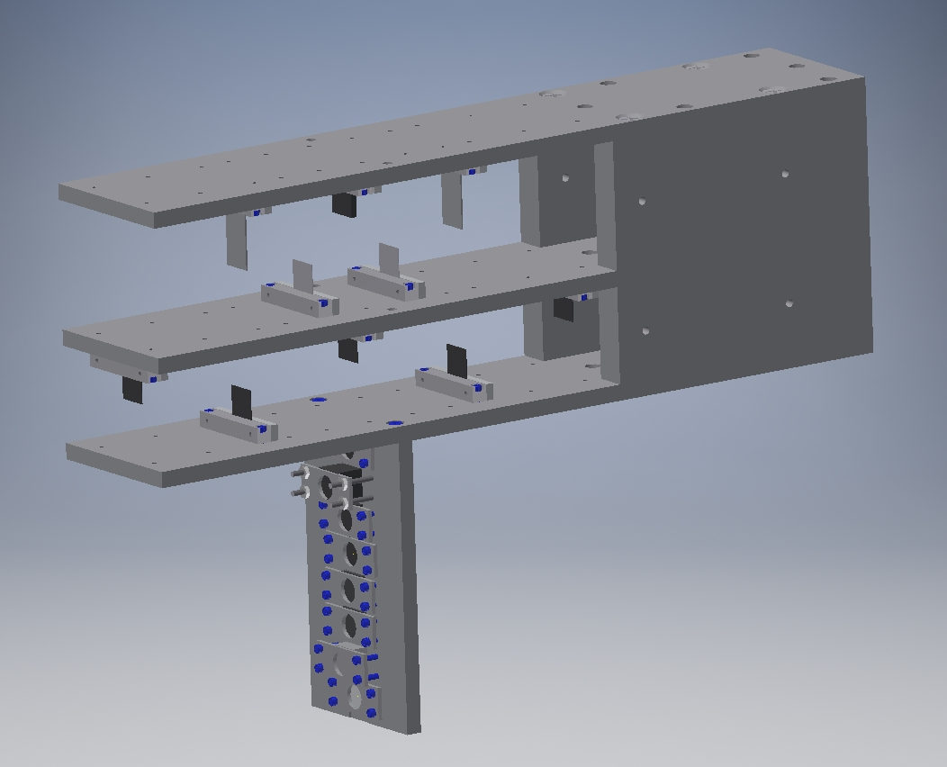
Dummy and Optics Targets
Targets can be positioned quickly
Positions for
0
+/- 2
+/- 3.75
+/- 5
+/- 7.5
+/- 10 cm
Current Optics Config:
0 and +/- 10 cm
+/- 5 cm

Slide 7
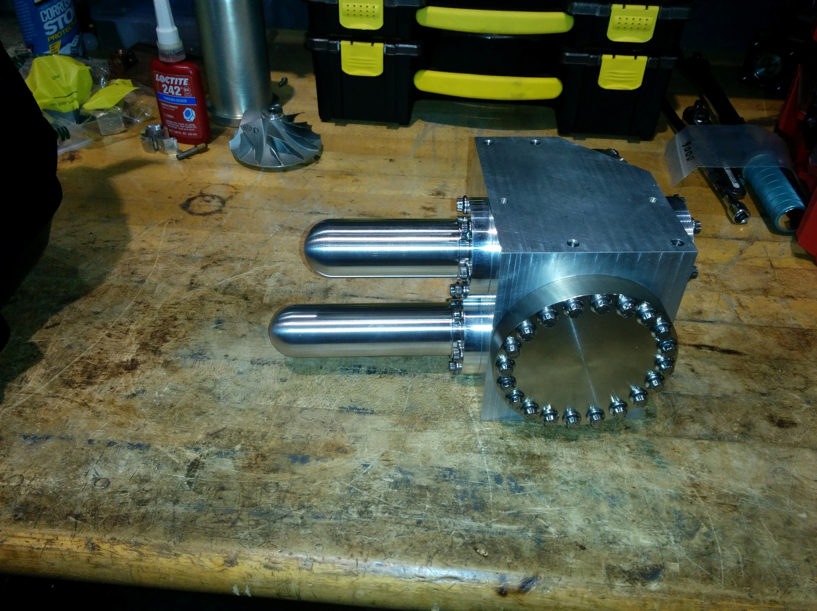
Fully assembled 4cm/10cm combined cell block

Slide 8
Test Cryostat
New test cryostat (developed in Summer 2016)
Test components at design temperature and pressure
Temperature below 6K
Pressures above 200 psi.
Allows testing of fully assembled cell blocks, feedthrus, etc.
Aid in development of future sealing techniques

Slide 9
Cryogenics
ESR 15K circuit shall be used to cool the target
Hall A target will be operated concurrently
Two target operation will require close coordination between CRYO, Hall C and Hall A.

Slide 10
Status
Complete
Tank refurbishment (compliant with 6151)
Tank support structure repair/painting
New loops, solid targets*
New alignment system*
Upgraded gas panel and piping
New swap panel
Upgraded controls
Software*
Heaters (higher voltage, lower current)*
Temp controls (6 per loop)*
Aux heater controls (all power supplies are in Hall)*
In process
10 cm production cells (2.6 inch OD)
Installation of piping
Installation of cells/blocks
Electrical upgrades
* Same as Hall A cryotarget

